Slide 1
SOFTWARE ENGINEERING
CHAPTER 1:
INTRODUCTION TO SOFTWARE ENGINEERING

Slide 2
What is Software?
The product that software professionals build and then support over the long term.
Software comprises of: (1) instructions (computer programs) that when executed provide desired features, function, and performance; (2) data structures that enable the programs to adequately store and manipulate information and (3) documentation that describes the operation and use of the programs.

Slide 3
Software Products
Generic products
  Stand-alone systems that are marketed and sold to any customer who wishes to buy them.
  Examples – PC software such as editing, graphics programs, project management tools; CAD software; software for specific markets such as appointments systems for dentists.
Customized products
  Software that is commissioned by a specific customer to meet their own needs.
  Examples – embedded control systems, air traffic control software, traffic monitoring systems.

Slide 4
Software Costs
Software costs often dominate computer system costs. The costs of software on a PC are often greater than the hardware cost.
Software costs more to maintain than it does to develop. For systems with a long life, maintenance costs may be several times development costs.
Software engineering is concerned with cost-effective software development.

Slide 5
Features of Software
Software is developed or engineered, it is not manufactured in the classical sense which has quality problem.
Software doesn't "wear out.” but it deteriorates (due to change). Hardware has bathtub curve of failure rate ( high failure rate in the beginning, then drop to steady state, then cumulative effects of dust, vibration, abuse occurs).
Although the industry is moving toward component-based construction (e.g. off-the-shelf integrated circuits), most software continues to be custom-built. Modern reusable components encapsulate data and processing into software parts to be reused by different programs. E.g. graphical user interface, window, pull-down menus in library etc.

Slide 6
Wear vs. Deterioration

Slide 7
Software Engineering Definition
The Seminal definition:
  [Software engineering is] the establishment and use of sound engineering principles in order to obtain economically software that is reliable and works efficiently on real machines.
The IEEE definition:
  Software Engineering: (1) The application of a systematic, disciplined, quantifiable approach to the development, operation, and maintenance of software; that is, the application of engineering to software. (2) The study of approaches as in (1).

Slide 8
Importance of Software Engineering
More and more, individuals and society rely on advanced software systems. We need to be able to produce reliable and trustworthy systems economically and quickly.
It is usually cheaper, in the long run, to use software engineering methods and techniques for software systems rather than just write the programs as if it was a personal programming project. For most types of system, the majority of costs are the costs of changing the software after it has gone into use.

Slide 9
A Layered Technology
Software Engineering
tools
methods
process model
a “quality” focus
Any engineering approach must rest on organizational commitment to quality which fosters a continuous process improvement culture.
Process layer as the foundation defines a framework with activities for effective delivery of software engineering technology. Establish the context where products (model, data, report, and forms) are produced, milestone are established, quality is ensured and change is managed.
Method provides technical how-to’s for building software. It encompasses many tasks including communication, requirement analysis, design modeling, program construction, testing and support.
Tools provide automated or semi-automated support for the process and methods.

Slide 10
Software Processes
What is a process?
  Sequence of steps required to develop or maintain software
Characteristics
  prescribes major activities
  constraints and controls apply to activities, resources, and products
  utilizes resources, subject to constraints such as schedule, to produce intermediate and final results
  constraints on activities: time, budget, tools
  controls on activities: config. mgmt, reports

Slide 11
A Process Framework
Process framework
  Framework activities
    work tasks
    work products
    milestones & deliverables
    QA checkpoints
  Umbrella Activities

Slide 12
Common Process Framework Activities
Communication
Planning
Modeling
  Analysis of requirements
  Design
Construction
  Code generation
  Testing
Deployment

Slide 13
Umbrella Activities
Software project tracking and control
Formal technical reviews
Software quality assurance
Software configuration management
Work product preparation and production (activities to create models, documents, logs, forms, lists, etc.)
Reusability management (defines criteria for work product reuse and establish mechanisms to achieve component reuse)
Measurement
Risk management

Slide 14
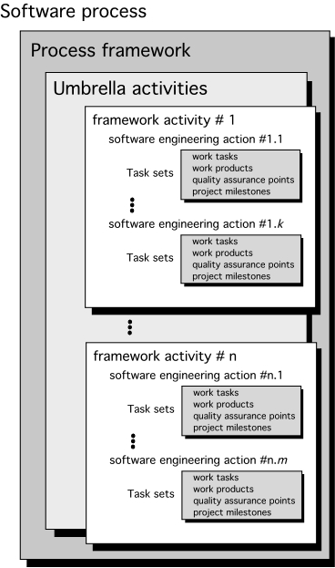
A Generic Process Model

Slide 15
Software Myths
Erroneous beliefs about software and the process that is used to build it.
Affect managers, customers (and other non-technical stakeholders) and practitioners
Are believable because they often have elements of truth,
but …
Invariably lead to bad decisions,
therefore …
Insist on reality as you navigate your way through software engineering

Slide 16
Software Myths Examples
Myth 1: Once we write the program and get it to work, our job is done.
Reality: the sooner you begin writing code, the longer it will take you to get done. 60% to 80% of all efforts are spent after software is delivered to the customer for the first time.
Myth 2: Until I get the program running, I have no way of assessing its quality.
Reality: technical review are a quality filter that can be used to find certain classes of software defects from the inception of a project.
Myth 3: software engineering will make us create voluminous and unnecessary documentation and will invariably slow us down.
Reality: it is not about creating documents. It is about creating a quality product. Better quality leads to a reduced rework. Reduced work results in faster delivery times.

Slide 17
Case studies
A personal insulin pump
  An embedded system in an insulin pump used by diabetics to maintain blood glucose control.
A mental health case patient management system
  A system used to maintain records of people receiving care for mental health problems.
A wilderness weather station
  A data collection system that collects data about weather conditions in remote areas.

Slide 18
Insulin pump control system
Collects data from a blood sugar sensor and calculates the amount of insulin required to be injected.
Calculation based on the rate of change of blood sugar levels.
Sends signals to a micro-pump to deliver the correct dose of insulin.
Safety-critical system as low blood sugars can lead to brain malfunctioning, coma and death; high-blood sugar levels have long-term consequences such as eye and kidney damage.

Slide 19
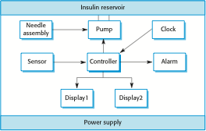
Insulin Pump Hardware Architecture

Slide 20
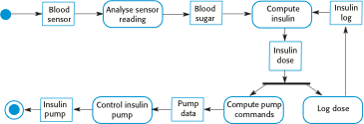
Activity model of the insulin pump

Slide 21
Essential high-level requirements
The system shall be available to deliver insulin when required.
The system shall perform reliably and deliver the correct amount of insulin to counteract the current level of blood sugar.
The system must therefore be designed and implemented to ensure that the system always meets these requirements.

Slide 22
A patient information system for mental health care
A patient information system to support mental health care is a medical information system that maintains information about patients suffering from mental health problems and the treatments that they have received.
Most mental health patients do not require dedicated hospital treatment but need to attend specialist clinics regularly where they can meet a doctor who has detailed knowledge of their problems.
To make it easier for patients to attend, these clinics are not just run in hospitals. They may also be held in local medical practices or community centres.

Slide 23
MHC-PMS
The MHC-PMS (Mental Health Care-Patient Management System) is an information system that is intended for use in clinics.
It makes use of a centralized database of patient information but has also been designed to run on a PC, so that it may be accessed and used from sites that do not have secure network connectivity.
When the local systems have secure network access, they use patient information in the database but they can download and use local copies of patient records when they are disconnected.

Slide 24
MHC-PMS goals
To generate management information that allows health service managers to assess performance against local and government targets.
To provide medical staff with timely information to support the treatment of patients.

Slide 25
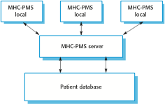
The organization of the MHC-PMS

Slide 26
MHC-PMS key features
Individual care management
  Clinicians can create records for patients, edit the information in the system, view patient history, etc. The system supports data summaries so that doctors can quickly learn about the key problems and treatments that have been prescribed.
Patient monitoring
  The system monitors the records of patients that are involved in treatment and issues warnings if possible problems are detected.
Administrative reporting
  The system generates monthly management reports showing the number of patients treated at each clinic, the number of patients who have entered and left the care system, number of patients sectioned, the drugs prescribed and their costs, etc.

Slide 27
MHC-PMS concerns
Privacy
  It is essential that patient information is confidential and is never disclosed to anyone apart from authorised medical staff and the patient themselves.
Safety
  Some mental illnesses cause patients to become suicidal or a danger to other people. Wherever possible, the system should warn medical staff about potentially suicidal or dangerous patients.
  The system must be available when needed otherwise safety may be compromised and it may be impossible to prescribe the correct medication to patients.

Slide 28
Wilderness weather station
The government of a country with large areas of wilderness decides to deploy several hundred weather stations in remote areas.
Weather stations collect data from a set of instruments that measure temperature and pressure, sunshine, rainfall, wind speed and wind direction.
  The weather station includes a number of instruments that measure weather parameters such as the wind speed and direction, the ground and air temperatures, the barometric pressure and the rainfall over a 24-hour period. Each of these instruments is controlled by a software system that takes parameter readings periodically and manages the data collected from the instruments.

Slide 29

The weather station’s environment

Slide 30
Weather information system
The weather station system
  This is responsible for collecting weather data, carrying out some initial data processing and transmitting it to the data management system.
The data management and archiving system
  This system collects the data from all of the wilderness weather stations, carries out data processing and analysis and archives the data.
The station maintenance system
  This system can communicate by satellite with all wilderness weather stations to monitor the health of these systems and provide reports of problems.

